Slide 1
Elements of Communication

Slide 2
Introduction
Communication is the process of exchanging information, ideas, and feelings.
Effective communication requires several key elements.
The process of exchange of ideas, views, facts, feelings, etc., between two or more persons in order to reach a common understanding is known as Communication.
"Communication is the sum of all things, a person does when he wants to create an understanding in the minds of another. It involves a systematic and continuous process of telling, listening and understanding" - Louis Allen

Slide 3
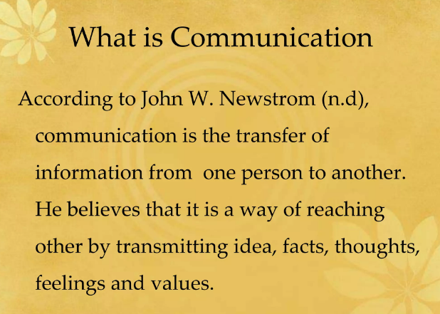

Slide 4
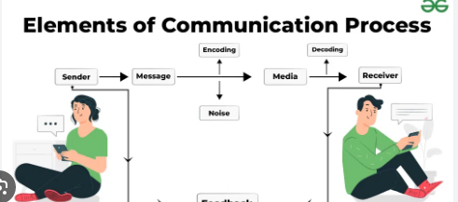

Slide 5
Sender
The communicator who starts the process.
Example: Teacher, speaker, manager.
The communication process begins with the sender, who is also called the communicator or source. The sender has some kind of information—a command, request, question, or idea—that he or she wants to present to others. For that message to be received, the sender must first encode the message in a form that can be understood, such as by the use of a common language or industry jargon, and then transmit it.

Slide 6
Message
The idea, information, or thought to be conveyed.
Example: A lecture, instructions, feelings.
The message or content is the information that the sender wants to relay to the receiver. Additional subtext can be conveyed through body language and tone of voice. Put all three elements together—the sender, receiver, and message—and you have the communication process at its most basic level.

Slide 7
Encoding
Process of converting thoughts into words, symbols, or gestures.
Example: Writing an email, giving a speech, using gestures.
The process of converting messages into communication symbols, which may be understood by the receiver. It includes words, pictures, gestures, symbols, etc. Encoding translates the internal thought of the sender into a language which can be understandable.

Slide 8
Channel (Medium)
The medium through which the message travels.
Examples: Face-to-face, telephone, email, social media.
The Medium
Also called the channel, the medium is the means by which a message is transmitted. Text messages, for example, are transmitted through the medium of cell phones. Other common mediums of communication include television broadcasts, radio waves, internet platforms, and face-to-face interactions.

Slide 9
Receiver
The person or group for whom the message is intended.
Example: Students in class, employees in a company.
The person to whom a message is directed is called the receiver or the interpreter. To comprehend the information from the sender, the receiver must first be able to receive the sender's information and then decode or interpret it.

Slide 10
Decoding
The receiver’s process of interpreting the message.
Example: Understanding instructions, interpreting emotions.
The process of translating the encoded message into an effective language, which can be understood by the receiver is known as decoding. In this, the encoded symbols of the sender are converted.

Slide 11
Feedback
The receiver’s response to the sender.
Example: Asking questions, nodding, replying.
The communication process reaches its final point when the message has been successfully transmitted, received, and understood. The receiver, in turn, responds to the sender, indicating comprehension. Feedback may be direct, such as a written or verbal response, or it may take the form of an act or deed in response (indirect).

Slide 12
Noise (Barriers)
Anything that distorts or blocks communication.
Examples: Physical noise, language barriers, poor internet, distractions.
Any construction or hindrance which hampers the communication process is known as noise. The hindrance may be caused to the sender, message or receiver. It acts as a barrier to effective communication and because of this message is interpreted differently by the receiver. Disturbance in the telephone line, inattentive receiver, faulty decoding, poor internet connection, improper gestures and postures, etc., are some examples of noise.

Slide 13
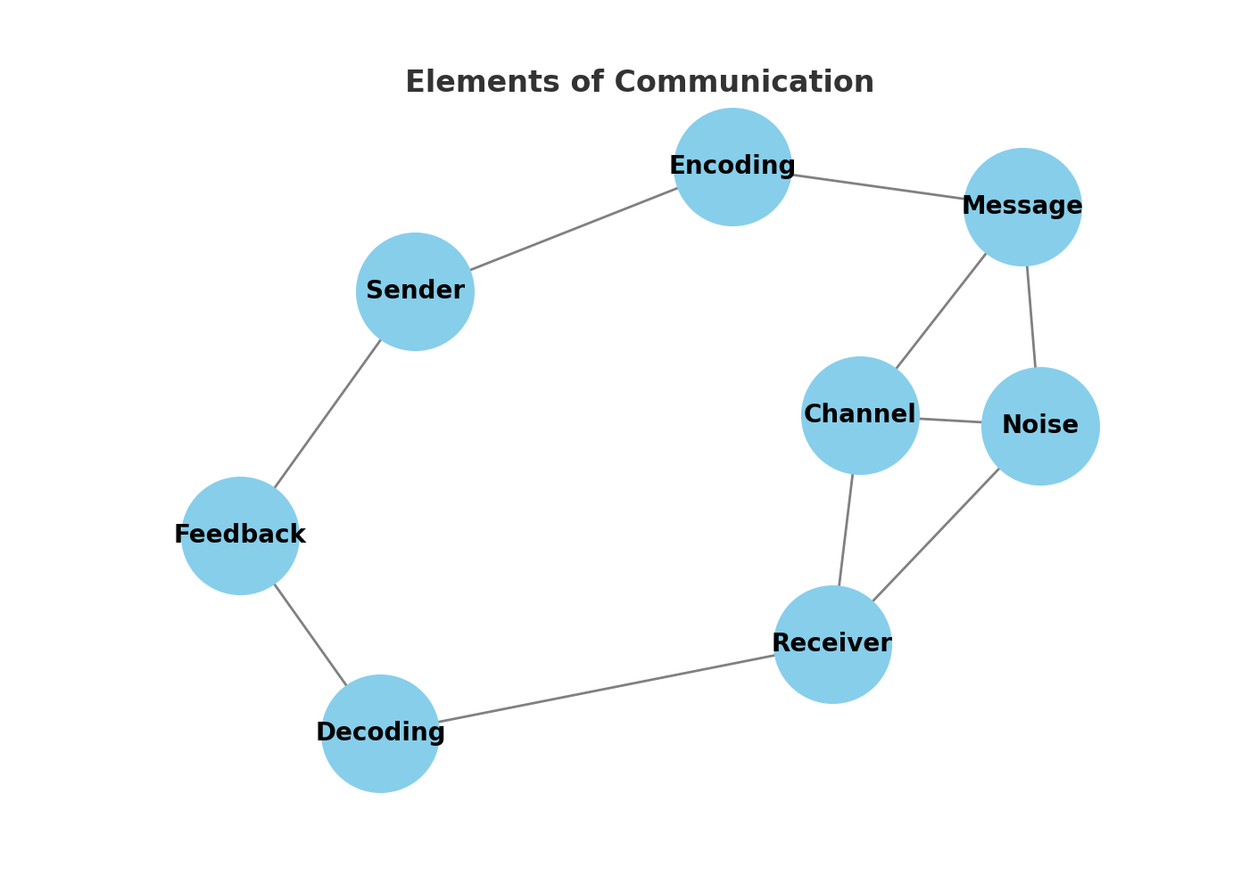
Communication Process Diagram

Slide 14
Key Principles of Effective Writing
Clarity:
Make sure your writing is easy to understand, with no ambiguity or confusion.
Conciseness:
Get to the point without unnecessary words or lengthy details.
Correctness:
Ensure your information is accurate, and your grammar and punctuation are right.
Audience Awareness:
Write for your reader by considering their needs, knowledge, and purpose for reading.
Active Voice:
Use active voice whenever possible to make your writing more direct and energetic.

Slide 15
Key Principles of Effective Writing
Plain Language:
Use simple, everyday words rather than complex or technical terms, explaining them if necessary.
Organization:
Structure your writing logically, sticking to a main topic and using headings or lists to improve readability.
Precision:
Use specific and vivid words to help readers visualize and understand your meaning.
Brevity:
Respect your reader's time by keeping sentences and paragraphs short and to the point.
Revision:
Always proofread your work, and consider having a colleague review it, to catch errors and improve clarity.

Slide 16
Practical Tips for Effective Writing
State your main point first: to provide immediate context for the reader.
Limit each paragraph to one idea: to maintain focus and readability.
Avoid nominalization: (turning verbs into nouns) to keep your writing more dynamic.
Do not be afraid to use short sentences: to convey your message simply and directly.
Use headings, bullet points, and lists: to break up text and make it easier to skim and digest.

Slide 17
Conclusion
Communication is effective when all elements work together.
Understanding these elements improves clarity and reduces misunderstanding.

